Slide 1
Mess Attendance
Analysis
By Anurag Chauhan

Slide 2
Problem Statement
Managing food preparation in large institutions like IIT hostels is challenging due to fluctuating attendance influenced by multiple factors such as weather, events, and exam schedules. Over-preparation leads to wastage, while under-preparation causes dissatisfaction among students. This project aims to analyze mess attendance trends to provide actionable insights for optimizing resource planning and minimizing food waste.

Slide 3
Data Collection
Data was synthetically generated for a semester (15 Jan – 15 May), representing attendance for breakfast,
lunch, and dinner.
Each dataset includes:
Date and Day of Week
Weather Conditions (Sunny, Cloudy, Rainy)
Exam Week Indicator
Special Events (Movie Screening, Festival, Holiday, Sports, Cultural, Tech)
Recorded Attendance Count
Patterns were embedded to reflect realistic behaviors, such as higher dinner attendance on non-veg days and reduced attendance during rainy weather or events.

Slide 4
Exploratory Data Analysis(EDA)
The raw datasets contained missing values and inconsistencies.
Cleaning steps included:
Handling missing values using appropriate imputation or removal.
Standardizing date formats and categorical variables.
Removing irrelevant or duplicate records.
Ensuring attendance values fall within logical limits (150–200 base, adjusted by conditions).
The cleaned datasets were used for analysis and dashboard creation.

Slide 5
Power BI Dashboards
Interactive dashboards were created in Power BI for each meal type and a combined comparison:
Breakfast Dashboard: Highlights peak attendance on weekends.
Lunch Dashboard: Shows dependency on sunny class days and dips during exams.
Dinner Dashboard: Peaks on non-veg days (Wed & Sat), lower on event days.
Comparison Dashboard: Side-by-side view for overall patterns.
Filters allow analysis by weather, events, and exam weeks.

Slide 6
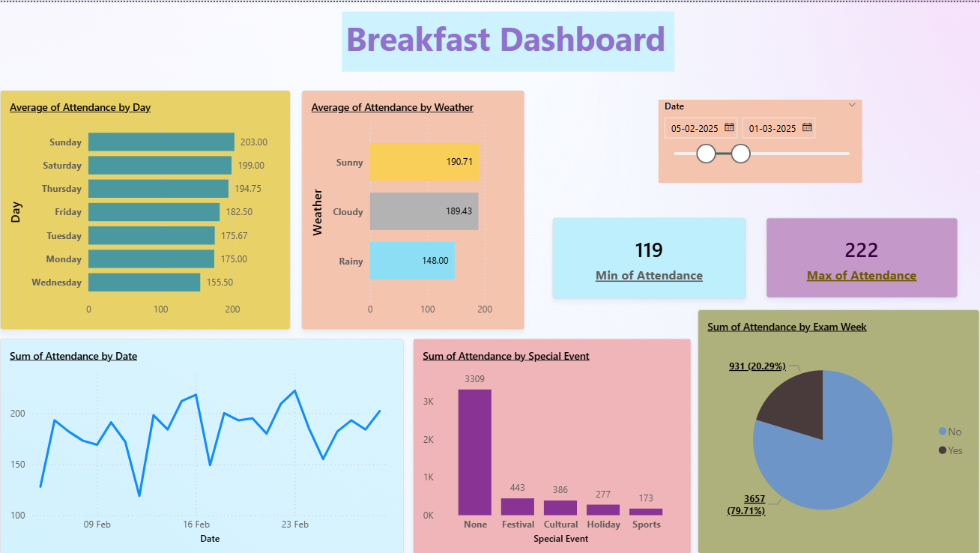

Slide 7
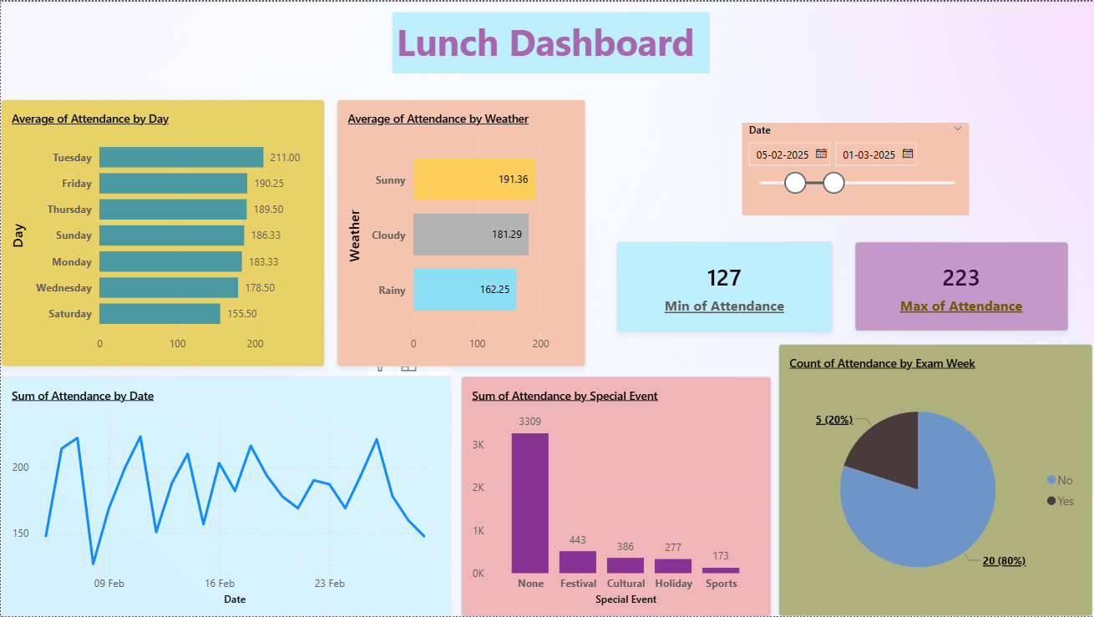

Slide 8
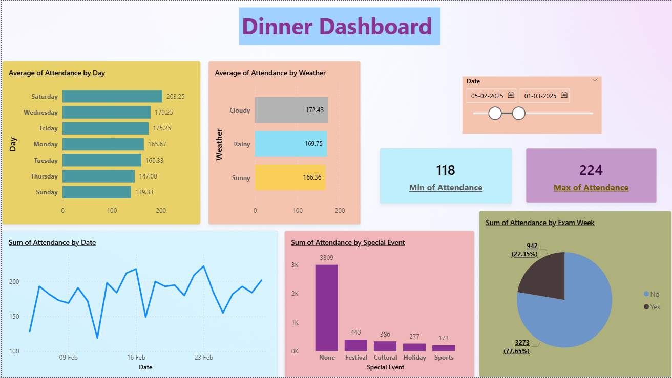

Slide 9
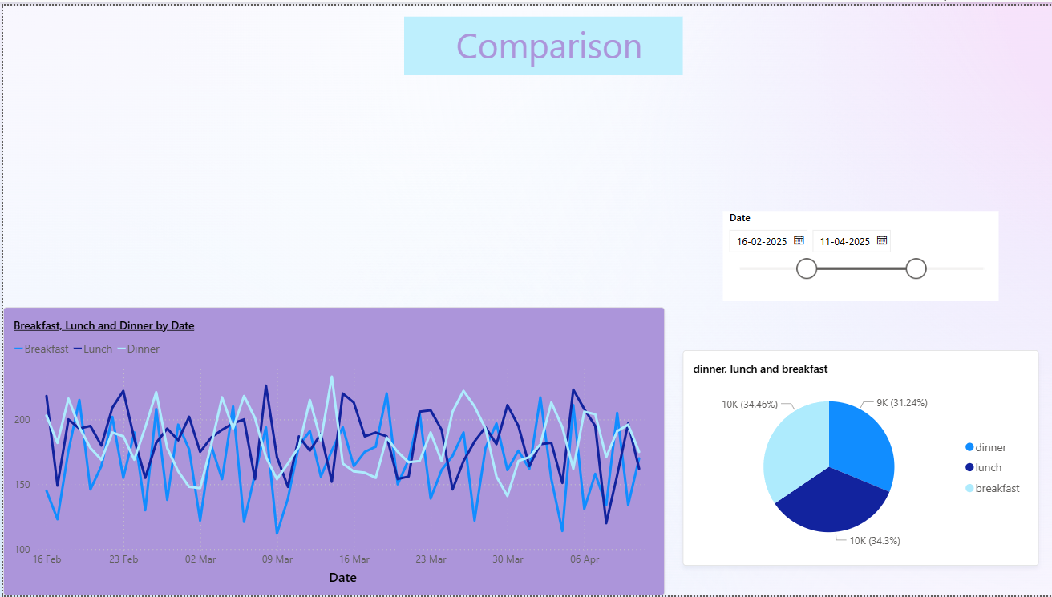

Slide 10
Insights
Breakfast had the highest average attendance, especially on Saturdays and Sundays, likely due to relaxed schedules.
Lunch attendance peaked on class days (Monday–Friday, except holidays) and dropped during exam weeks.
Dinner attendance increased significantly on Wednesdays and Saturdays (non-veg days) but fell on event days like festivals and holidays.
Rainy weather consistently reduced attendance for all meals.
Sunny weather boosted lunch attendance, while cloudy weather had minimal impact.
Exam weekend caused lunch dips but had minimal effect on breakfast and a mild boost in dinner.

Slide 11
Recommendations
Adjust food preparation based on day-of-week patterns to minimize waste.
Plan special offers or promotions for low-attendance dinners on Thursdays or holidays.
Stock more on high-demand days (weekend breakfasts, Wednesday/Saturday dinners).
Consider covered dining or delivery options on rainy days to maintain attendance.
Monitor event schedules (festivals, sports, tech events) to adjust resources accordingly.

Slide 12
Conclusion
This analysis highlights clear attendance patterns influenced by day of the week, weather, events, and exam schedules.
By leveraging these insights, the mess management team can optimize meal planning, reduce food waste, and improve student satisfaction.
The Power BI dashboards provide an interactive, visual method to track and adapt to changing attendance trends in real time.

